Slide 1


Slide 2


Slide 3


Slide 4


Slide 5
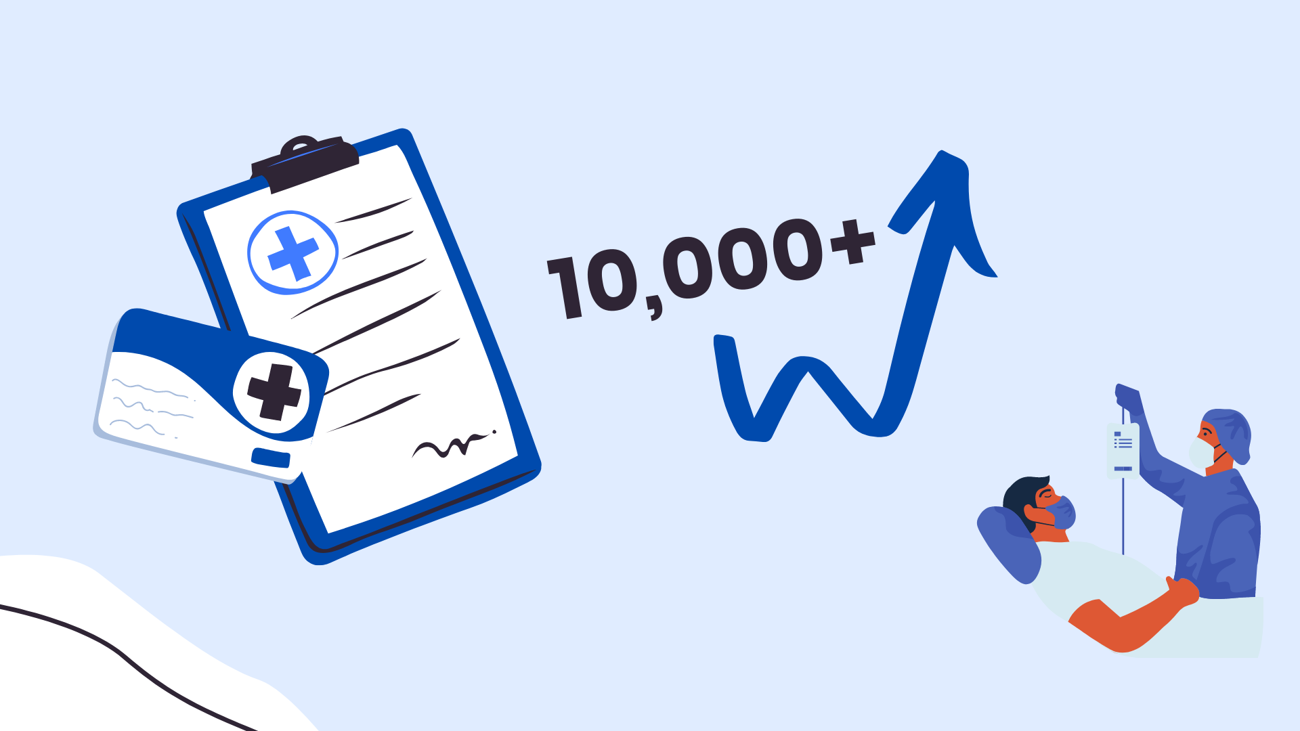

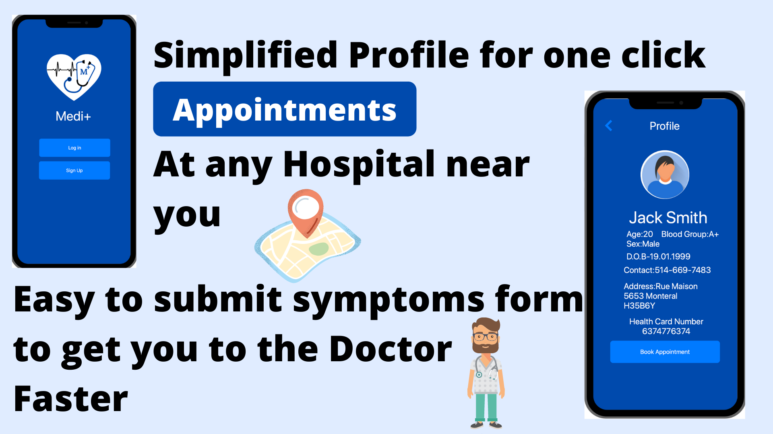

Slide 6
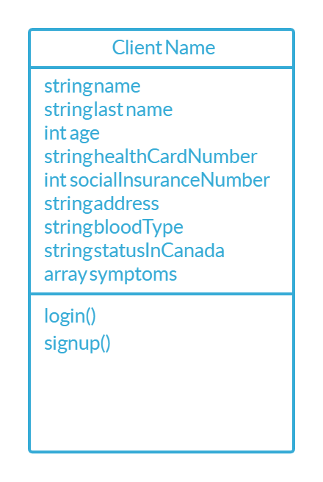
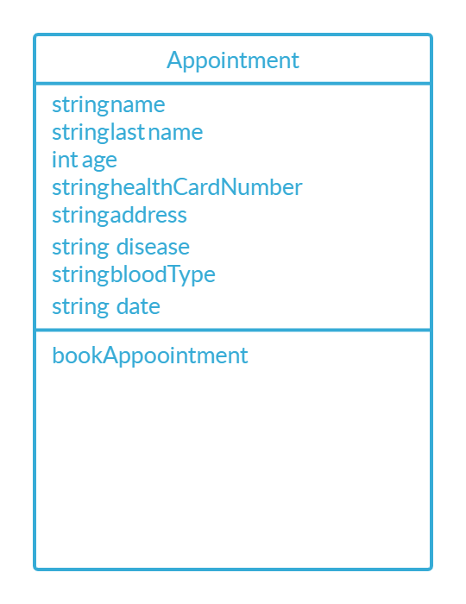
Class Diagram

Slide 7

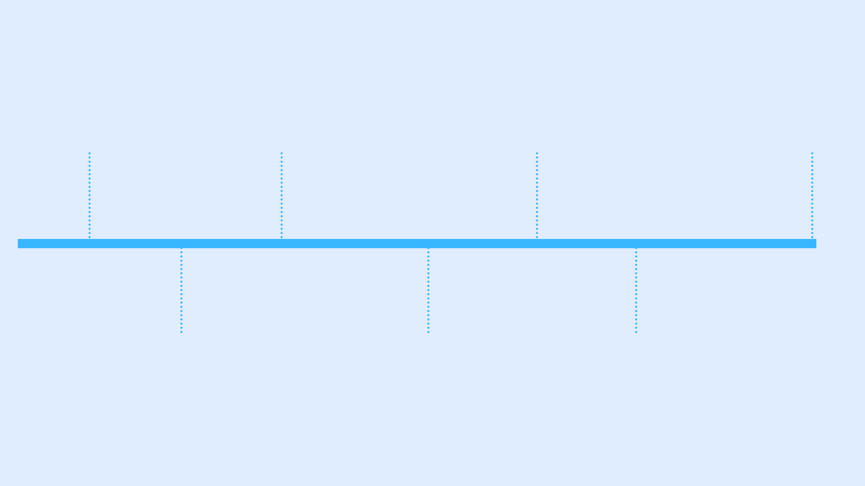
APP - TIME LINE
Discussion About Features
5 NOV -10 NOV
Implementing Appointment Form
17 NOV -20 NOV
Debugging and Testing the Final build
23 NOV -1 DEC
Designing UI
5 NOV -10 NOV
Designing Database
11NOV -15 NOV
Implementing LOGIN AND SIGNUP
15 NOV -17 NOV
Implementing Symptoms Form
20 NOV -23 NOV

Slide 8

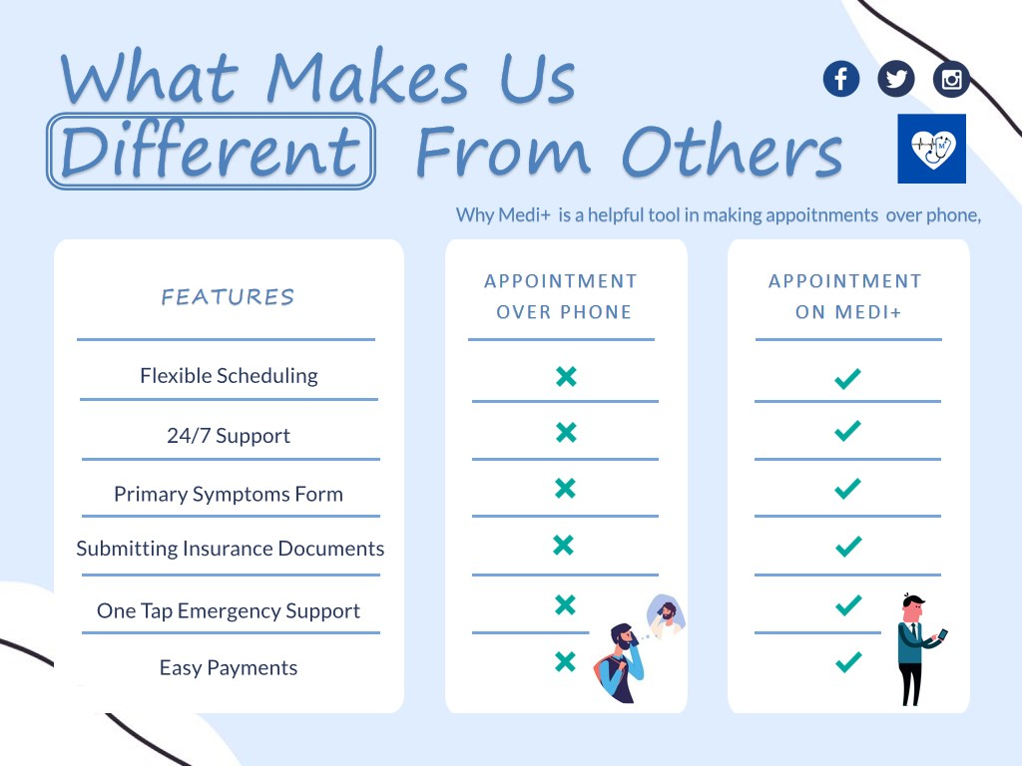

Slide 9
User Stories

Slide 10
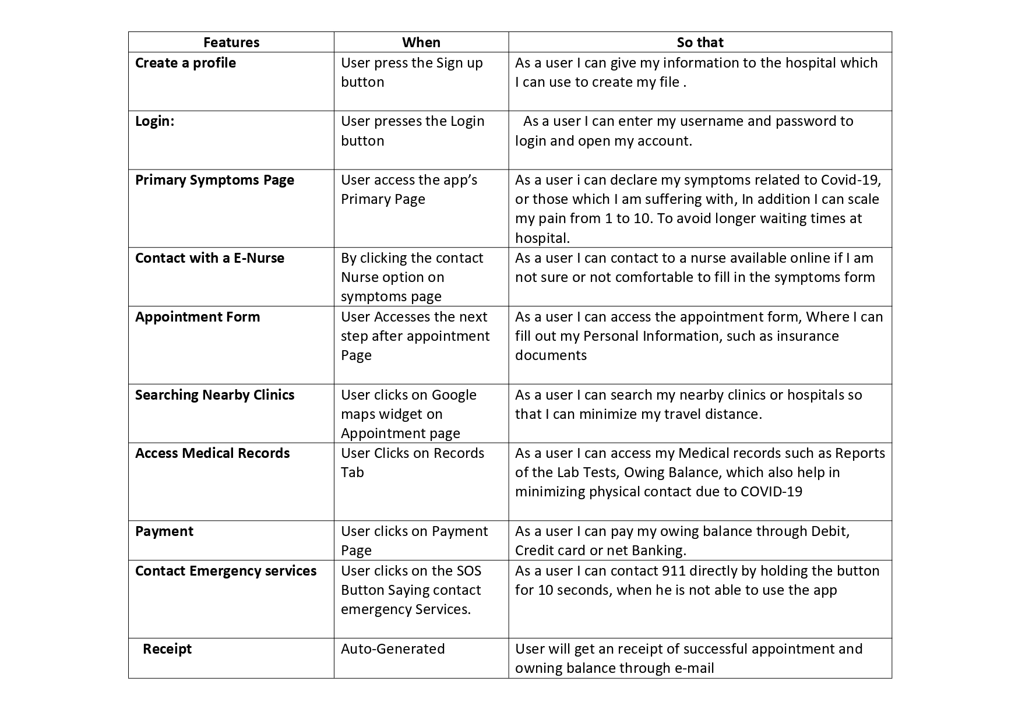

Slide 11
Improvements we consider for next sprint
Payment Options Via google pay for advance payment
Add Google Maps API
Storing Medical Records Visits and Issues

Slide 12
App Layout
First Edition

Slide 13
Signup

Slide 14
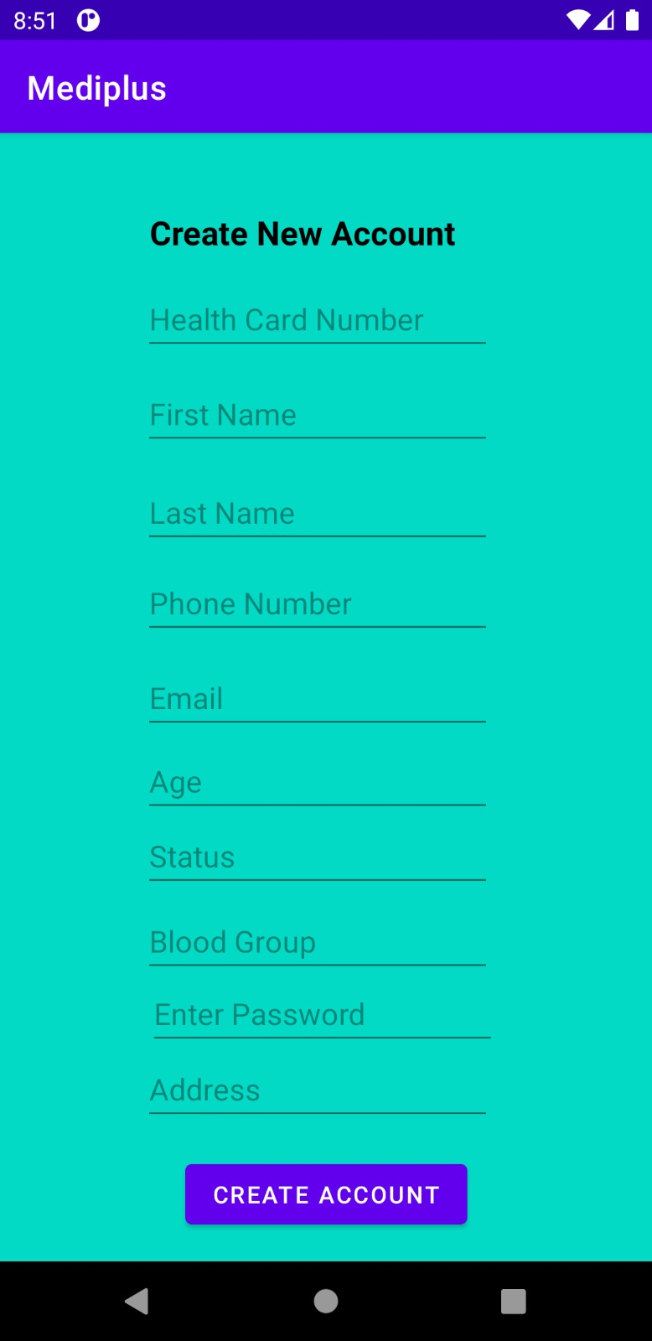

Slide 15
Login Screen

Slide 16
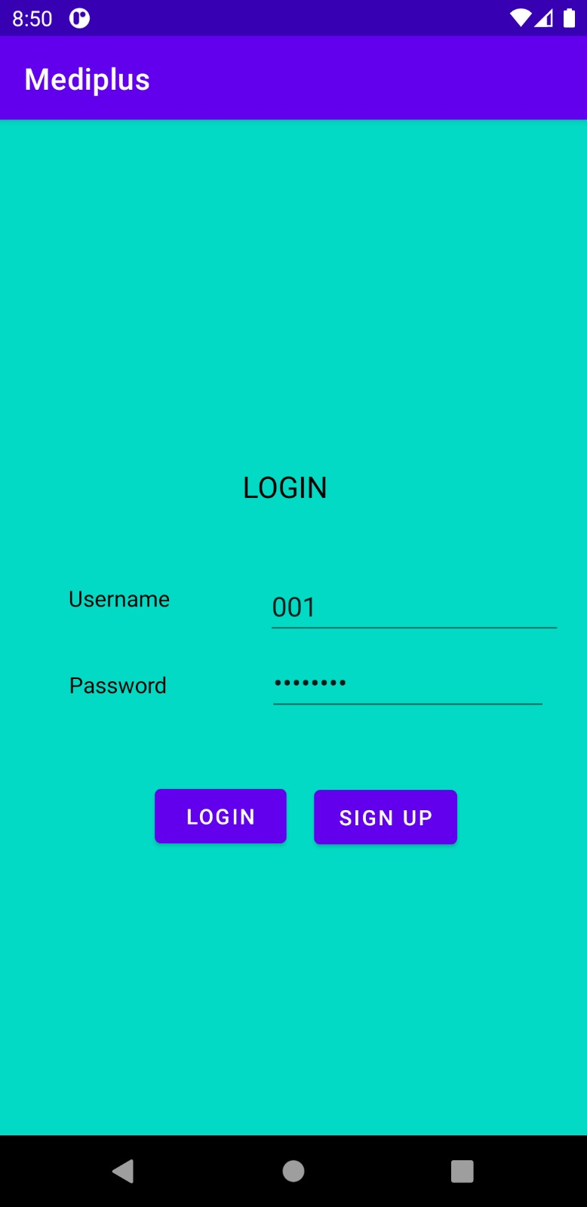

Slide 17
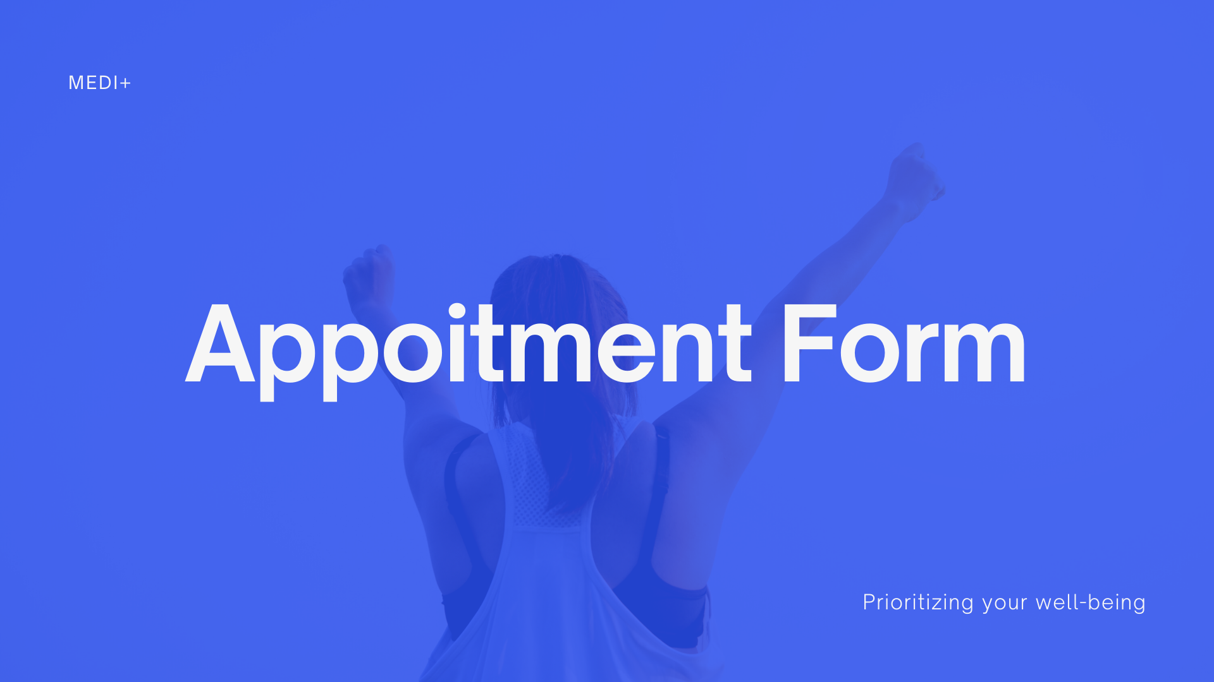
Appoit

Slide 18
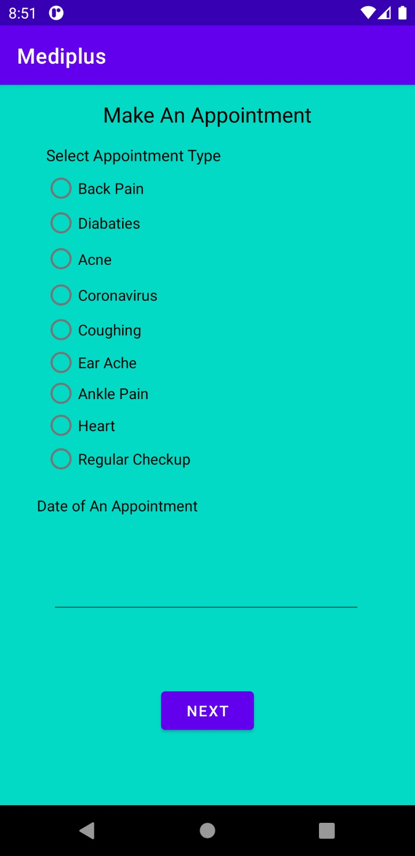

Slide 19
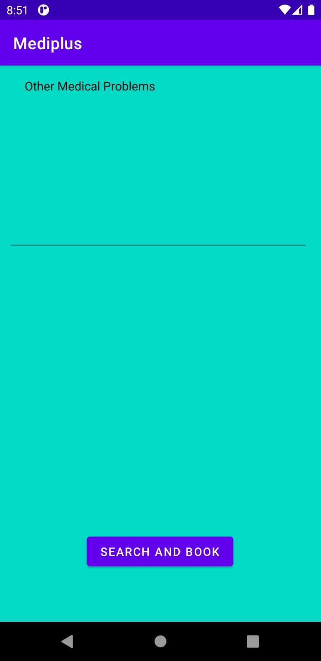

Slide 20
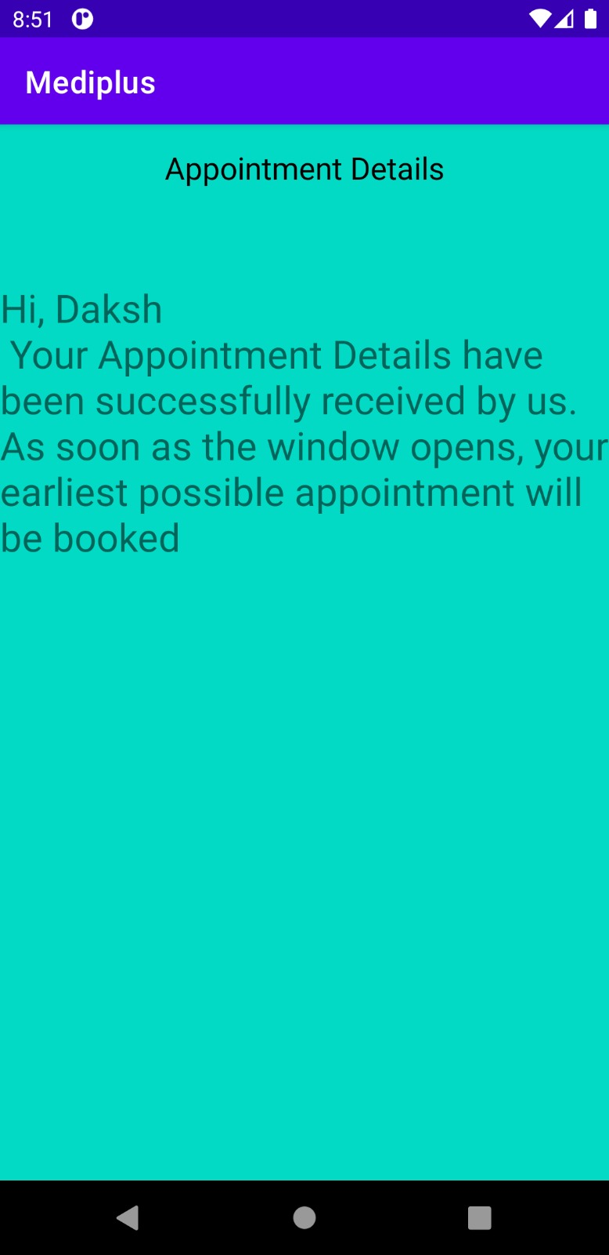

Slide 21
Database Design

Slide 22
